Slide 1
Handwritten notes to speech converter Team Name: Sy Clan Theme : Machine Learning

Slide 2
The outbreak of COVID-19 pandemic has led to the adoption of online teaching models by most schools, colleges and coaching institutes. Researches have shown that doctors are reporting many cases of eyestrain among students after online classes started. Many students have been diagnosed with computer vision syndrome. Our project focuses on this issue and provides a solution to this emerging problem by using the handwriting recognition of a machine to receive and interpret handwritten input from multiple sources like paper documents, photographs, screens, etc.

Slide 3
Solution and Idea
Our system provides way to students to avoid eyestrain and continue with their learning . Teacher can upload all the notes and rather than reading and straining their eyes student can listen to these notes. This system will convert text to speech format.
The project aims to design expert system for Students using Neural Network. that can effectively recognize a particular character of type format using the Neural Network approach. Neural computing Is comparatively new field, and design components are therefore less well specified than those of other architectures. Neural computers implement data parallelism. Neural computer are operated in way which is completely different from the operation of normal computers. Neural computer are trained (not Programmed) so that given a certain starting state (data input); they either classify the input data into one of the number of classes or cause the original data to evolve in such a way that a certain desirable property is optimized.

Slide 4
Unique Selling points
One click handwritten notes to speech
Centralized Data
Status
We provide easiest approach to access of handwritten study material provided by teachers to students in speech format
All the material is distributed according to different subjects as well as year and made available in single system
Teachers can also view seen status for each study material provided of every student

Slide 5
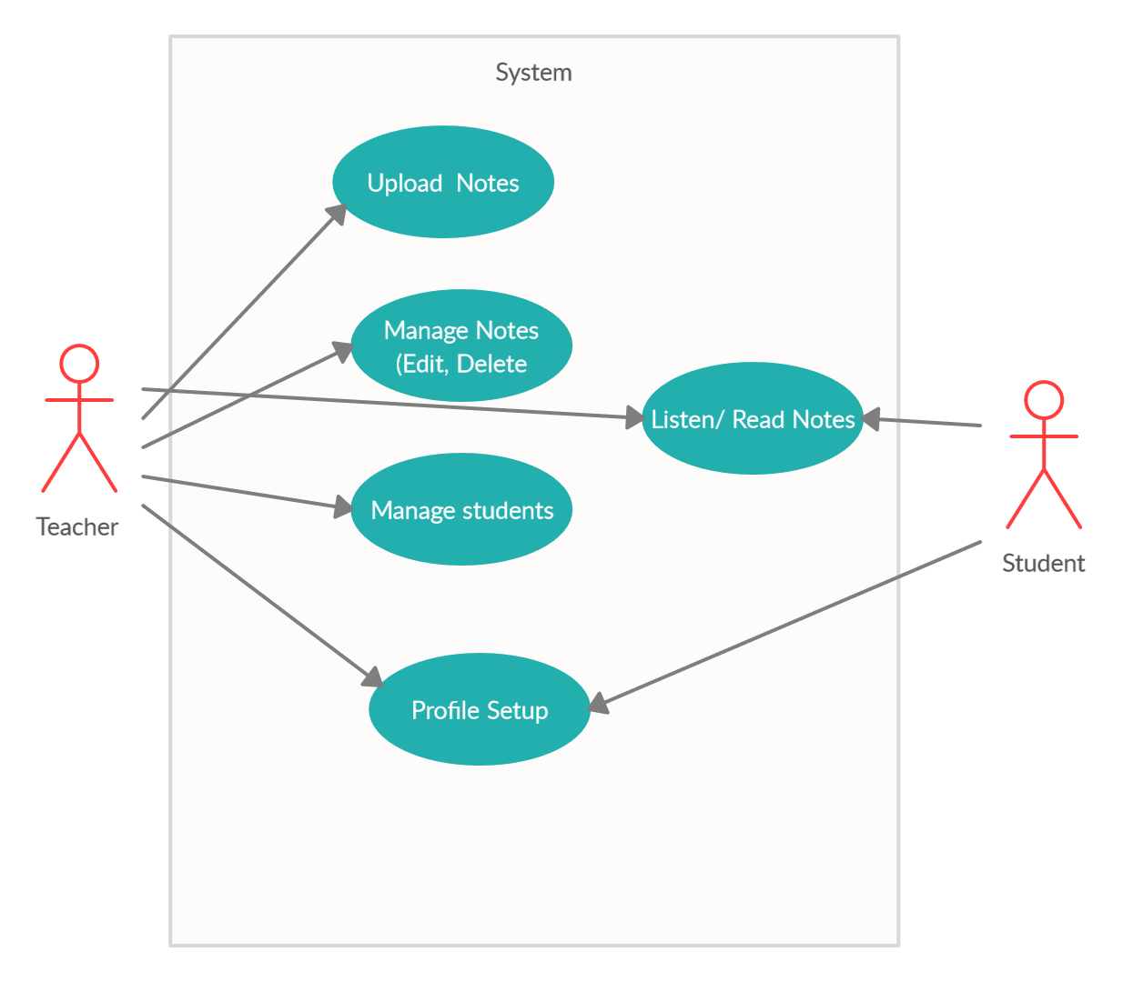
Use Case Diagram:

Slide 6
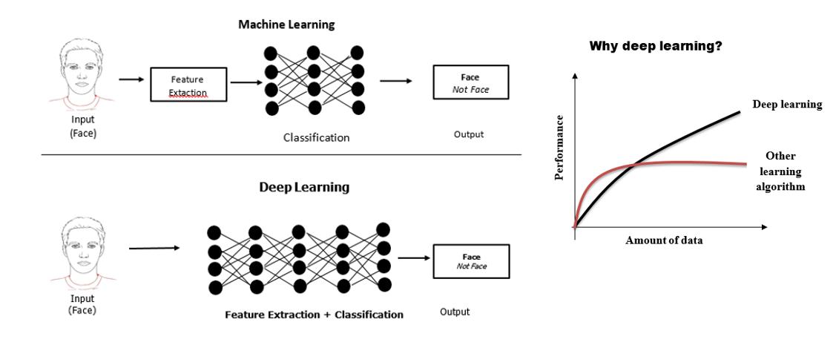
Why Deep Learning?
Technology Stack :
Frontend: HTML, CSS
Backend: Flask
Libraries:
Tensorflow
Numpy
OpenCv 3
API:
Google Text to Speech(gTTS)
Datasets:
Institut für Informatik und Angewandte Mathematik (IAM)
Database: MySQL

Slide 7
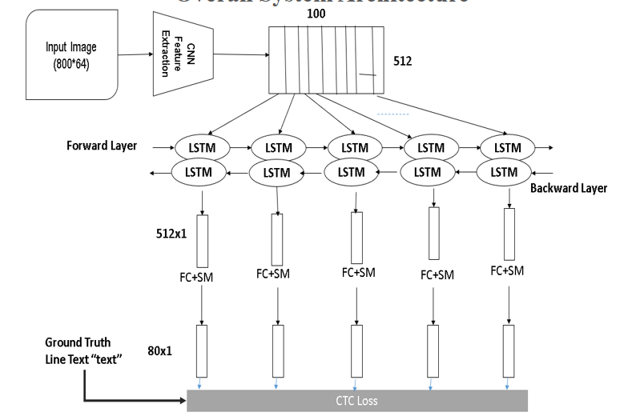
Project Workflow:
Part 1: Handwritten text to Normal text Conversion
7

Slide 8
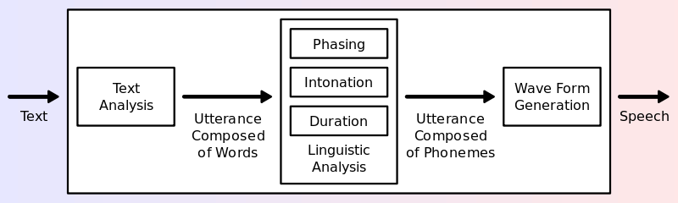
Project Workflow:
Part 2: Text to speech conversion
8

Slide 9
Future scope
Application can read images in more than one language.
Able to read mathematical complex equations.

